Slide 1
Predicting School Bus Breakdowns and Delays in NYC
Capstone Project by Team B Phase 2
Team Members: Nasim Aalemi, Shobha Panthi, James Gilmore
Dataset Link:
https://shorturl.at/OSbdS
GitHub Link:
https://github.com/naalemi/Predicting_NYC_School_Bus_Breakdowns_Capstone_Project-Team-B-

Slide 2
Project & Dataset Overview
This capstone project aims to analyze and model school bus breakdowns and delays in New York City using large-scale dataset.
Our project will combine exploratory data analysis, machine learning, interactive dashboard, and front-end predictive tool to uncover patterns, predict outcomes, and offer actionable insights.
We aim to identify the key operational factors contributing to school bus delays and breakdowns in NYC using a classification model and an interactive Power BI dashboard.
We are also developing a prediction model for delay duration using regression techniques, integrated with a Streamlit-based front-end application.

Slide 3
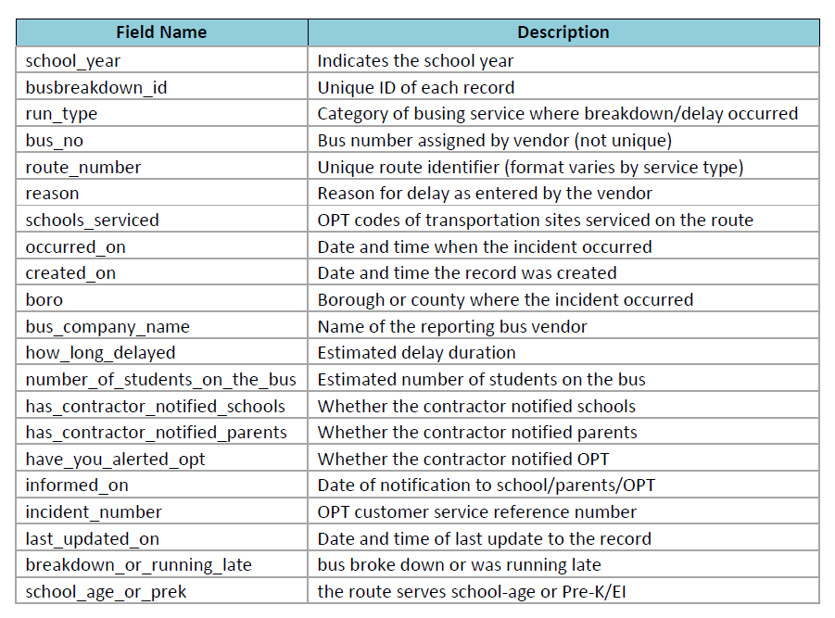
Project & Dataset Overview Continued
The NYC Bus Breakdowns and Delays dataset is updated daily on the NYC Open Data portal.
Source Link: https://shorturl.at/OSbdS
Dataset: NYC Bus Breakdown and Delays
Size: 228,427 records
Scope: Multi-year data
The dataset includes:
3 academic years (22-23 through 24-25)
Incident Information (delays or breakdowns)
Operational Details (reasons, run-type)
Contextual Data (how long, rout, boro, etc)
Response Behavior (notification or alerts)

Slide 4
Exploratory Data Analysis (EDA)
The dataset is raw real-world data directly pulled from NYC ODP. This type of data is often messy, unstructured, and inconsistent, which make cleaning it a significant challenge. Unlike curated datasets, which are typically pre-processed for analysis, this data required substantial effort to prepare it for meaningful insights and predictions.
Key Data Cleaning Focus Areas: 1) Bus_Company_Name, 2) Route_Number, 3) How_Long_Delayed
The Bus_Company_Name column contained numerous inconsistencies, including misspellings, abbreviations, and variations of the same company name. It wasn't unusual to see the same company listed under multiple names, making aggregation and analysis difficult.
The Route_Number column had missing values and formatting issues, where sometimes the number would appear as text, coupled with symbols like hashtag, or be completely absent, requiring us to infer and standardize the data.
How_Long_Delayed was especially tricky. The delay times were recorded in different units (minutes, hours) or sometimes even left blank, making it necessary to unify them into one consistent format and handle missing data carefully, as they often indicated a breakdown.

Slide 5
Modeling Approach
Classification:
Objective: Predict whether an incident is a "Breakdown" or "Running Late"
Run_Type, Route_Number, Reason, Boro, Bus_Company_Name, Number_Of_Students_On_The_Bus, School_Age_or_PreK, Occurred_On, Has_Contractor_Notified_School, Has_Contractor_Notified_Parents, Have_You_Alerted_OPT
Encode categorical variables:
(Run_Type, Reason, Boro, Bus_Company_Name, etc.) using OneHot or Target Encoding depending on the variable type.
Booleans like 'Has_Contractor_Notified_Parents' to binary (1/0)
Parse dates (Occurred_On) for: Hour of day, Day of week

Slide 6
Modeling Approach Continued
Regression:
Target Variable: 'How_Long_Delayed' (already converted to numeric minutes) using Gradient Boosting Regressor / XGBoost Regressor with MAE, RMSE, and R² as evaluation
Variables to use in the model the same as Classification with one exception. We will impute missing delay entries, given those are considered breakdowns.
Encode categorical variables: (Run_Type, Reason, Boro, Bus_Company_Name, etc.) using OneHot or Target Encoding depending on the variable type
Booleans like 'Has_Contractor_Notified_Parents' to binary (1/0)
Parse dates (Occurred_On) for: Hour of day, Day of week

Slide 7
Literature Review
Lack of Comparable Projects on School Bus Delay Prediction
Extensive search of academic journals, data science platforms (e.g., Kaggle), and public sector dashboards revealed very limited or no projects focused on Predictive modeling of school bus delays
Integrated tools or dashboards tailored for school transit performance
What Exists Instead
General transit bus status (e.g.,Transportation Status BCPS)
Bus delay or breakdown report (e.g., NYC Public Schools)
General articles highlighting the significance of minimizing bus delays

Slide 8
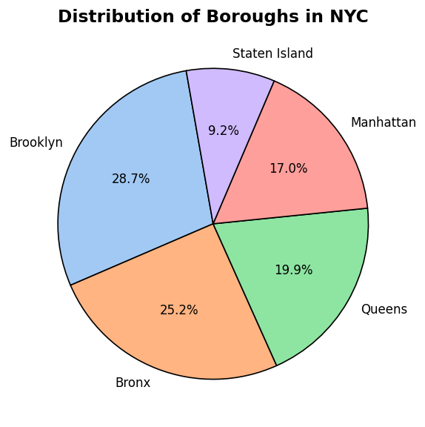
EDA Continued
The original dataset contained data of the entire state of New York.
Our goal was to focus on New York City (5 boroughs)
Some names included: Westchester, Nassau County, etc.
This graph gives us insight as to how frequent bus breakdowns or
delays happen in a city with the population of over 8 million people.

Slide 9
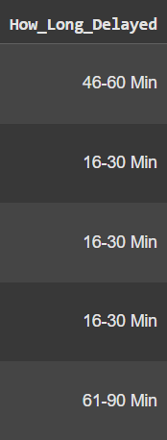
EDA How Long Delayed
Our main objective is to predict if an incident will be a bus breakdown or a delay
We used multiple standardization techniques to prepare the column
- Removing textual data and replacing them with integers (‘half hour’ to 30)
- Removed unnecessary strings that could affect aggregation (“!”,”#”,”.”,”/”,”?”)
- To the mean of values that gave a time range (46 - 60 Min)
- Found all matches on string values and removed them (“Min”,”minute”,”mins”,etc)
If a running late (delay) is GREATER THAN 300 minutes (5 hours), it will be classified as BREAKDOWN

Slide 10
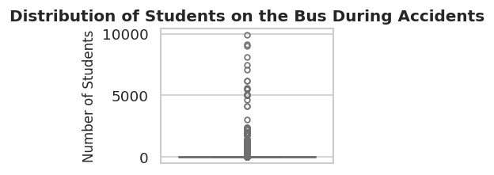
EDA: Number of Students on the Bus
The column “Number of Student on Bus” is a column that allows us to understand how these delays can impact the quantity of student learning
The average number of student that will fit on an NYC school bus is 72 students.
There were 105 outliers (Number varied, some ranging in the 1000s)

Slide 11
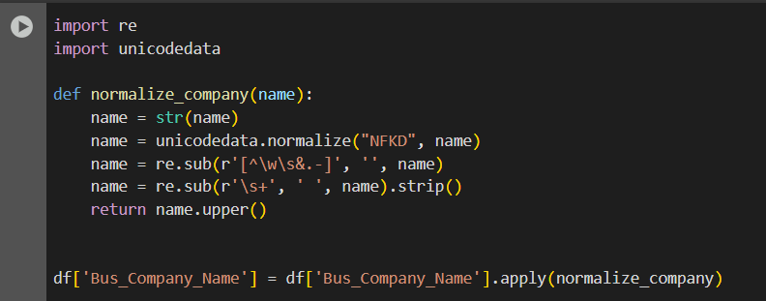
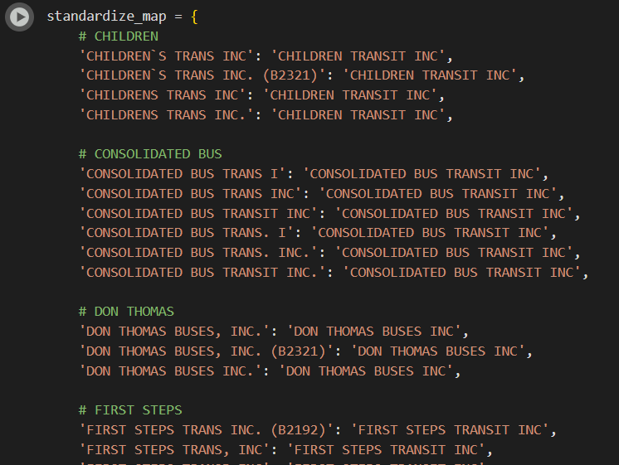
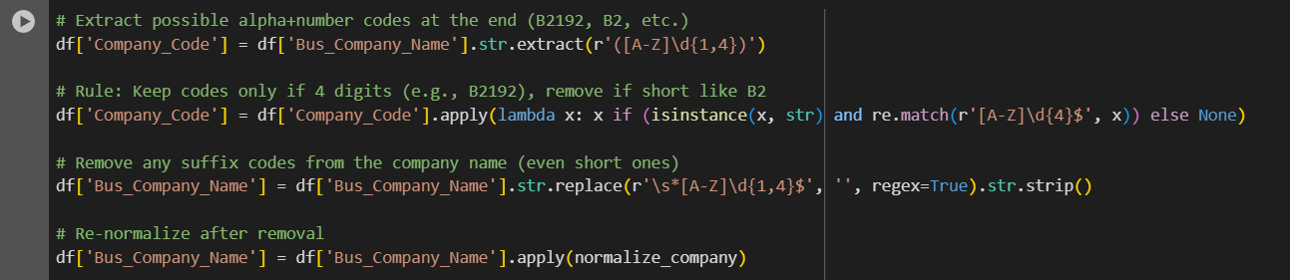
Company Names

Slide 12
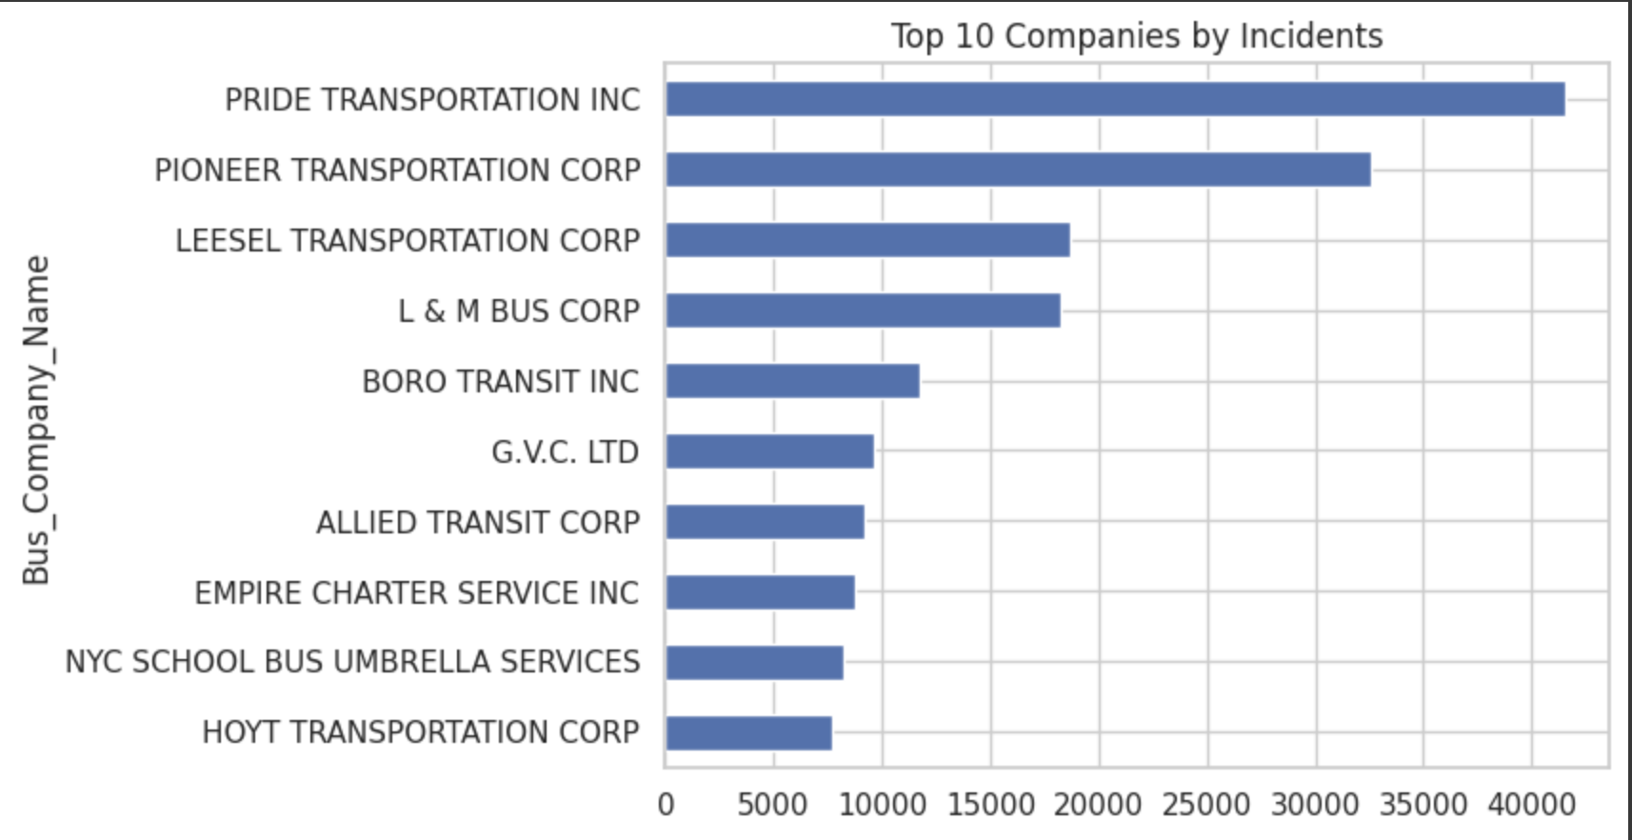
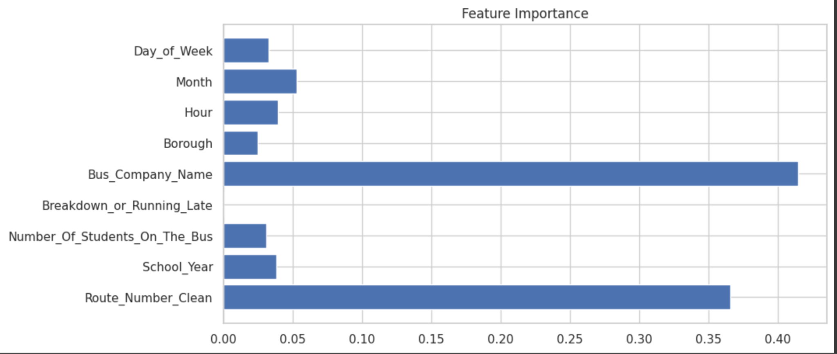
This chart shows that some companies like Pride and Pioneer have significantly more incidents. This could be because they operate more routes or have maintenance issues. It helps identify companies that might need more attention for service quality.
This chart shows which features are the most important in predicting how long buses are delayed. From the chart, we can see that the bus company name and the route number have the biggest impact on delays.So basically, who’s driving and where they’re going are the biggest factors in bus delays.

Slide 13
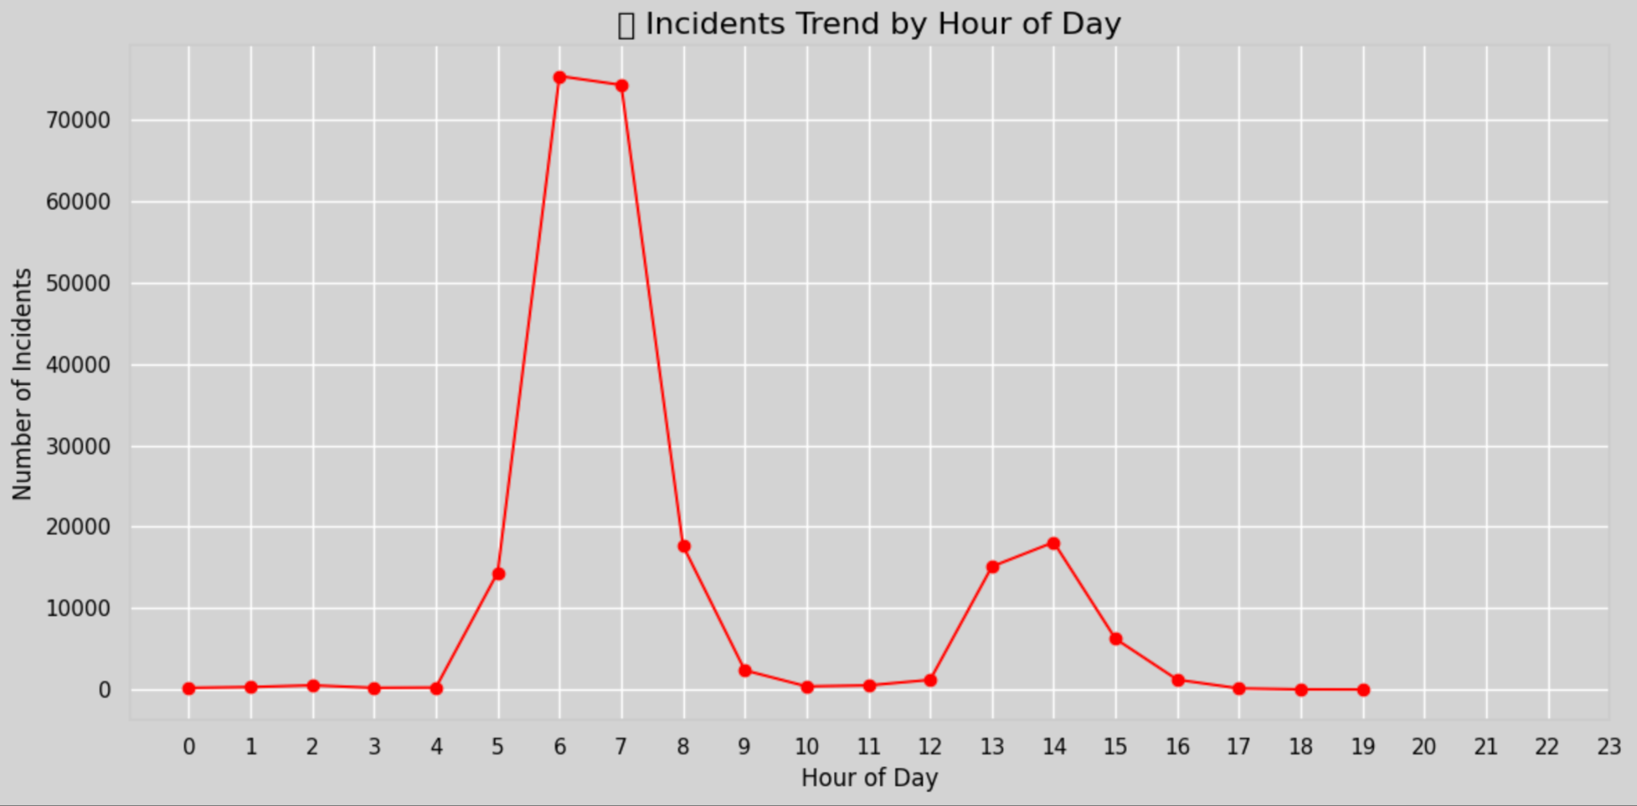
EDA: What time of Day do incidents occur the most?
To provide recommendations to the NYC Department of Education, we first need to understand WHEN these incidents occur the most
Military time - EX: Hours 13, 14, and 15 are 1pm, 2pm, and 3pm

Slide 14
Whats Next?
Week 7: Machine Learning (Nasim, Shobha, James)
Classification Model, Regression Model
Week 8: Frontend Implementation (Nasim, Shobha, James)
Power BI Dashboard or Visual Analytics, Streamlit Web App or Interactive Prediction Tool
Week 9: Final Presentation and Preparation (Nasim, Shobha, James)
Complete data analysis of Predicting School Bus Breakdowns and Delays in NYC. Create the final slides and prepare for project presentation.

Slide 15
References
Bus breakdown and delays | NYC Open Data. (2025, June 15).
https://data.cityofnewyork.us/Transportation/Bus-Breakdown-and-Delays/ez4e-fazm/about_data
OPT_Open_Data_Descriptions_V0.2 | NYC Open Data. (2025, June 16). https://data.cityofnewyork.us/Transportation/Bus-Breakdown-and-Delays/ez4e-fazm/about_data
Transportation status | Baltimore County Public Schools (2025, June 16).
https://www.bcps.org/parents/transportation_status
School Bus Delay | NYC Public Schools (2025, June 15).
https://www.opt-osfns.org/opt/vendors/busbreakdowns/public/default.aspx?search=YES

